Slide 1
COMMUNICATION SKILLS
NAM CSE preetham
1ST YEAR

Slide 2
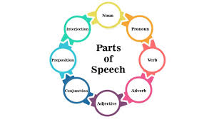
PARTS OF SPEECH

Slide 3


Slide 4

NOUN: Thing or person

Slide 5
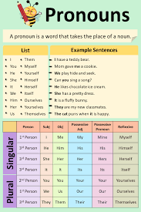
PRONOUN:Replaces a noun

Slide 6

VERB: Action or state

Slide 7
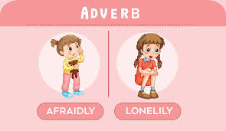
ADVERB:Describes a verb adjective or adverb

Slide 8
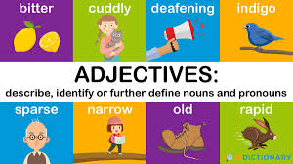
ADJECTIVE:Describes a noun

Slide 9
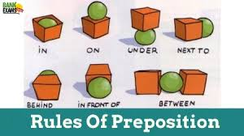
PREPOSITION:Links a noun to another word

Slide 10
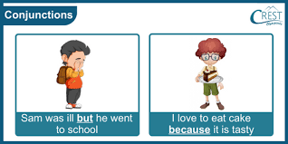
CONJUNCTION:Joins clauses or sentences or words

Slide 11

INTERJECTION:Short exclamination sometimes inserted into a sentences

Slide 12

THANK YOU MAM…

